Slide 1
Capital Construction Project Update March 12, 2019
Clifford Nooney
Director of Facilities

Slide 2
Priority 1 Project Scope Changes
Project Total as of February 11, 2019 |  | $30,618,764
Adjustments
Westmere: | Replace oil-fired hot water heater with an electric heater rather than converting to a natural gas heater | -$65,812
High School: | Add 1,000 feet of sewer pipe lining | +$154,861
Districtwide: | Additional cost escalation for 2021 project start | +$2,521
 | Revised Project Total | $30,710,334
For more information on the Proposed Capital Construction Project visit our website at www.guilderlandschools.org and click on Capital Project under Quick Links at the bottom of the homepage.

Slide 3
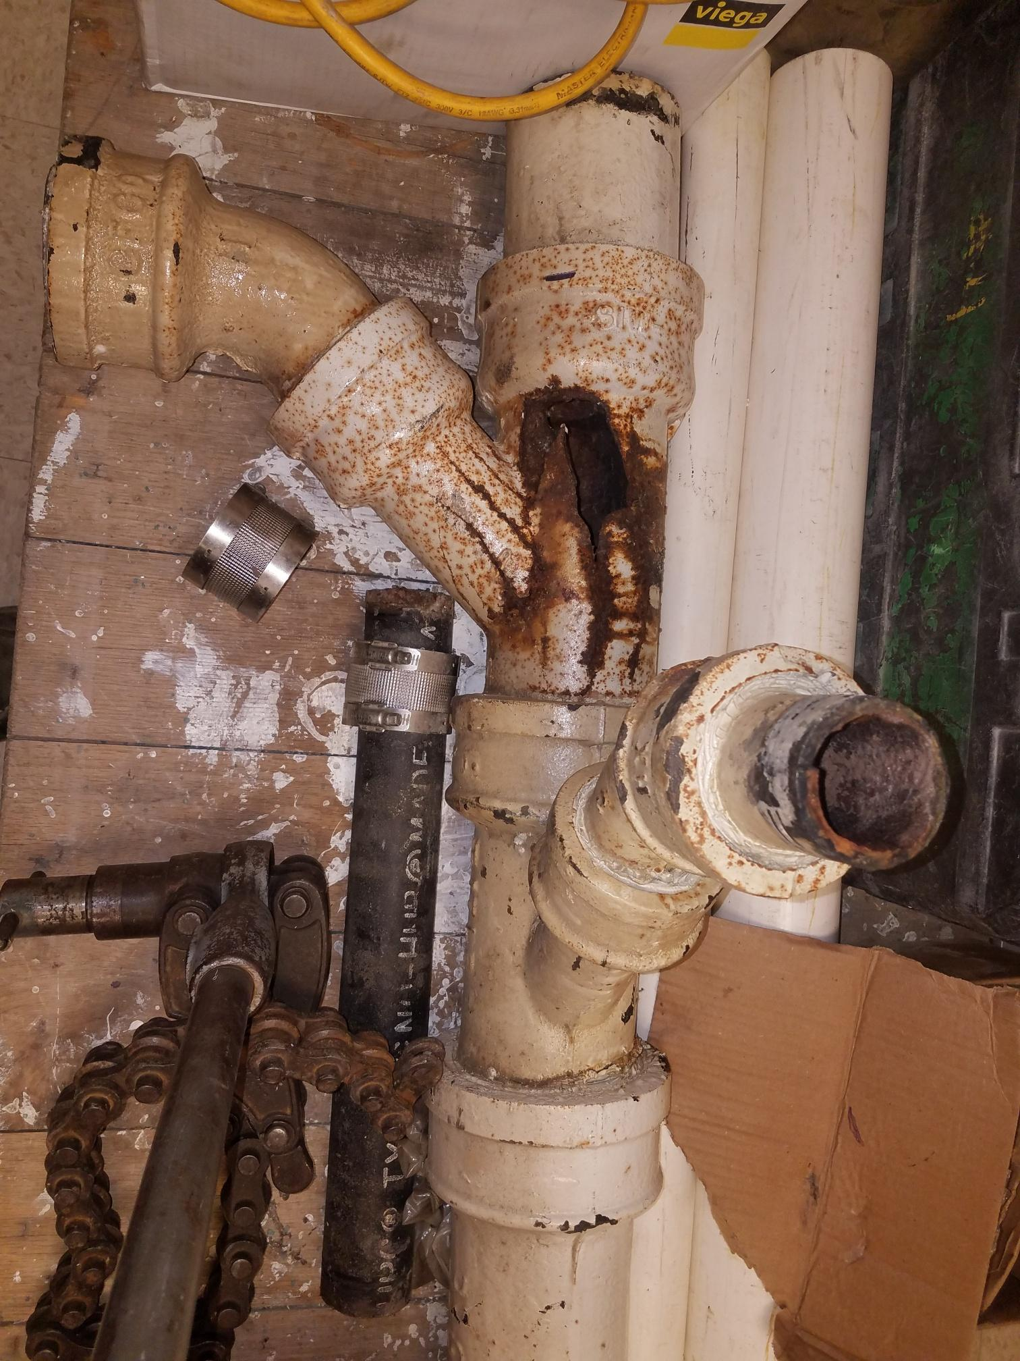
Aging Infrastructure

Slide 4
Capital Construction Project Cost
October 2018 Referendum | $42.7 M
Proposed Reductions | -$12.0 M
May 2019 Referendum | $30.7 M
Financed Amount $27.6 M*
Estimated Median Homeowner Tax Impact
October 2018 Referendum | $103
May 2019 Referendum | $65*
*Note: $3,150,000 from the Capital Reserve Fund will be applied
to lower the amount borrowed for the project.

