Slide 1
Proposed Facilities Improvements
FOLLOW UP TO JULY 1 PRESENTATION
Marie Wiles, Superintendent of Schools
Clifford Nooney, Director of Facilities
Dave Austin, Director of Health, PE and Athletics

Slide 2
Overview of Presentation
Response to July 1 Questions
Overview of Proposed New Work
Infrastructure Improvements
Outdoor Spaces
Technology Replacement/Enhancements
Proposed Project Timeline
Summary of Costs
Questions & Answers

Slide 3
AC Across the District?
Approximately 65% of all spaces in the district have either Mechanical Systems with Air Conditioning or a Window AC unit.
Link to maps

Slide 4
Air Conditioned Spaces
Building | Total Rooms | Rooms with AC | % of Building
Altamont ES | 50 | 40 | 80%
Guilderland ES | 64 | 52 | 81%
Lynnwood ES | 65 | 46 | 71%
Pine Bush ES | 79 | 58 | 73%
Westmere ES | 78 | 54 | 69%
Farnsworth MS | 248 | 141 | 57%
Guilderland HS | 337 | 211 | 63%
Totals | 921 | 602 | 65%

Slide 5
What elements of the 2018 project are included in the proposed project?
District Wide Analysis and Prioritization (7/1/21)

Slide 6
All Gender Restrooms?
Currently Labeled
Labeled Summer 2021
School | #
Altamont Elementary | 0
Guilderland Elementary | 0
Lynnwood Elementary | 0
Pine Bush Elementary | 1
Westmere Elementary | 4
Farnsworth Middle School | 6
Guilderland High School | 5
Facilities | 0
Transportation | 0
TOTAL | 16
School | #
Altamont Elementary | 17
Guilderland Elementary | 15
Lynnwood Elementary | 23
Pine Bush Elementary | 11
Westmere Elementary | 19
Farnsworth Middle School | 17
Guilderland High School | 15
Facilities | 2
Transportation | 2
TOTAL | 121

Slide 7
Proposed Work for Fall 2021 Vote

Slide 8
Three Focus Areas
Infrastructure Work Eliminated from 2018 Project $9,405,549 | Outdoor Spaces $4,878,958 | Technology Replacement and Data Security $3,157,967
Classroom Storage and Work Space Cabinetry | 5 Playground upgrades | Replace Classroom Projection Systems
Security Cameras | 7 Outdoor Classroom Pavilions | Virtualization
HVAC Equipment Including Boilers | New Track and Synthetic Turf Field
Roofing/Paving
Locker Replacement
Newly Identified Infrastructure Priority Needs: GHS Waterline, Windows, Slab Settlement, Tunnel Work; AES Sewage Ejector Pump; GES and FMS Nurses’ Office HVAC

Slide 9
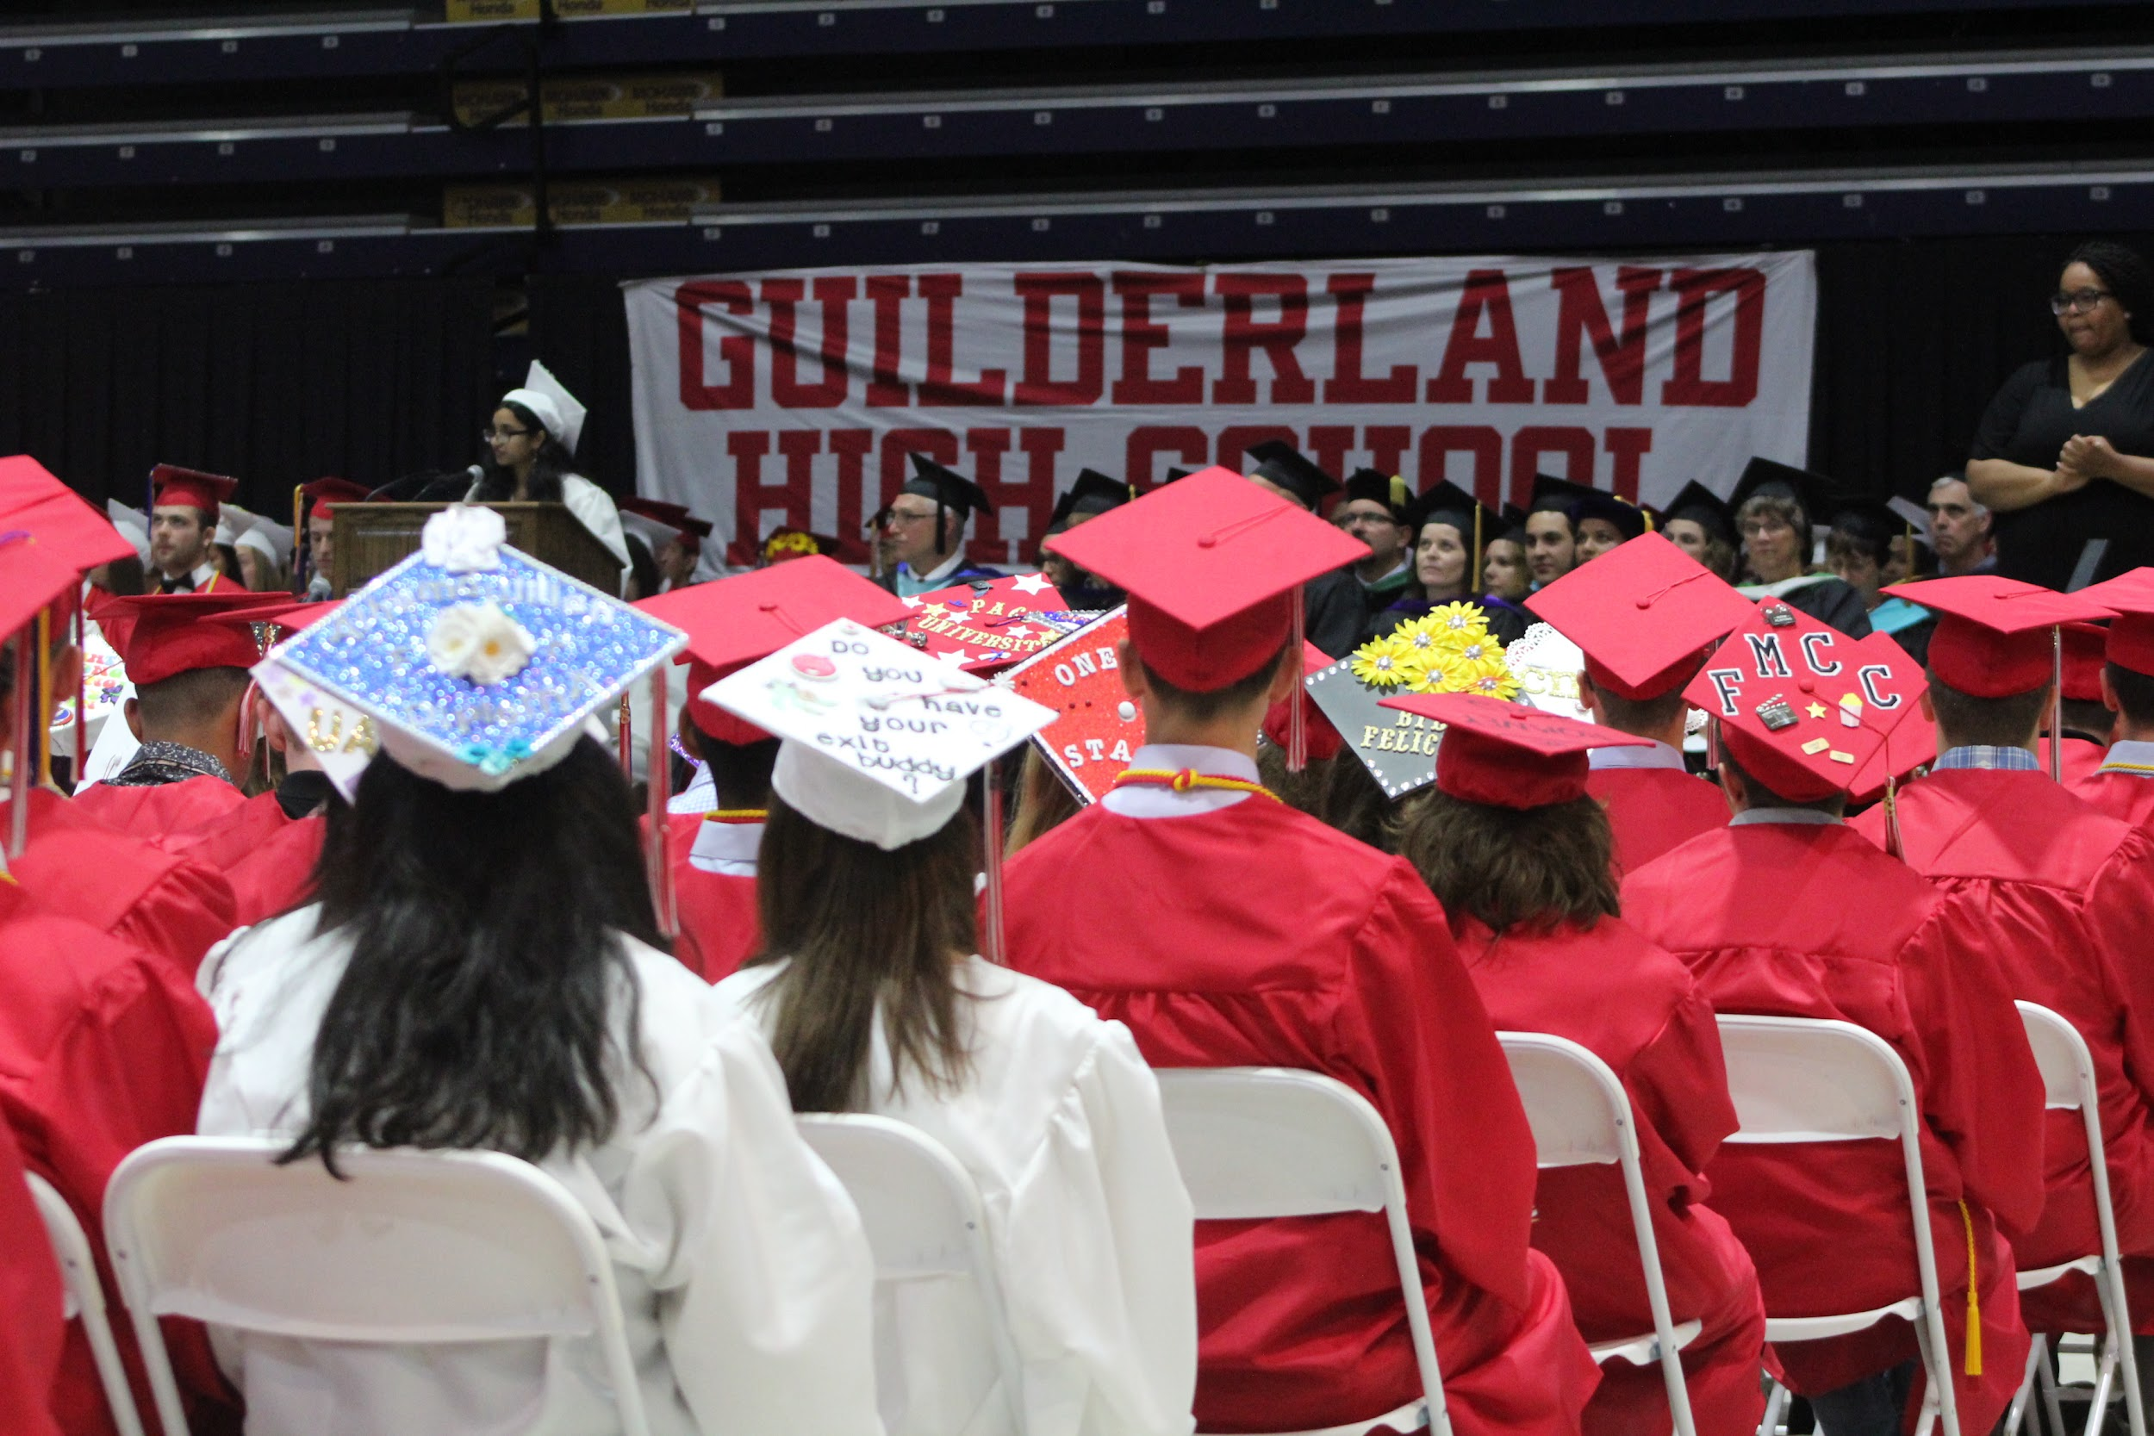
Why is GCSD proposing this capital construction project?
Improve the learning environment for our students
Provide the tools needed to engage in a modern teaching and learning environment
Expand opportunities for students

Slide 10
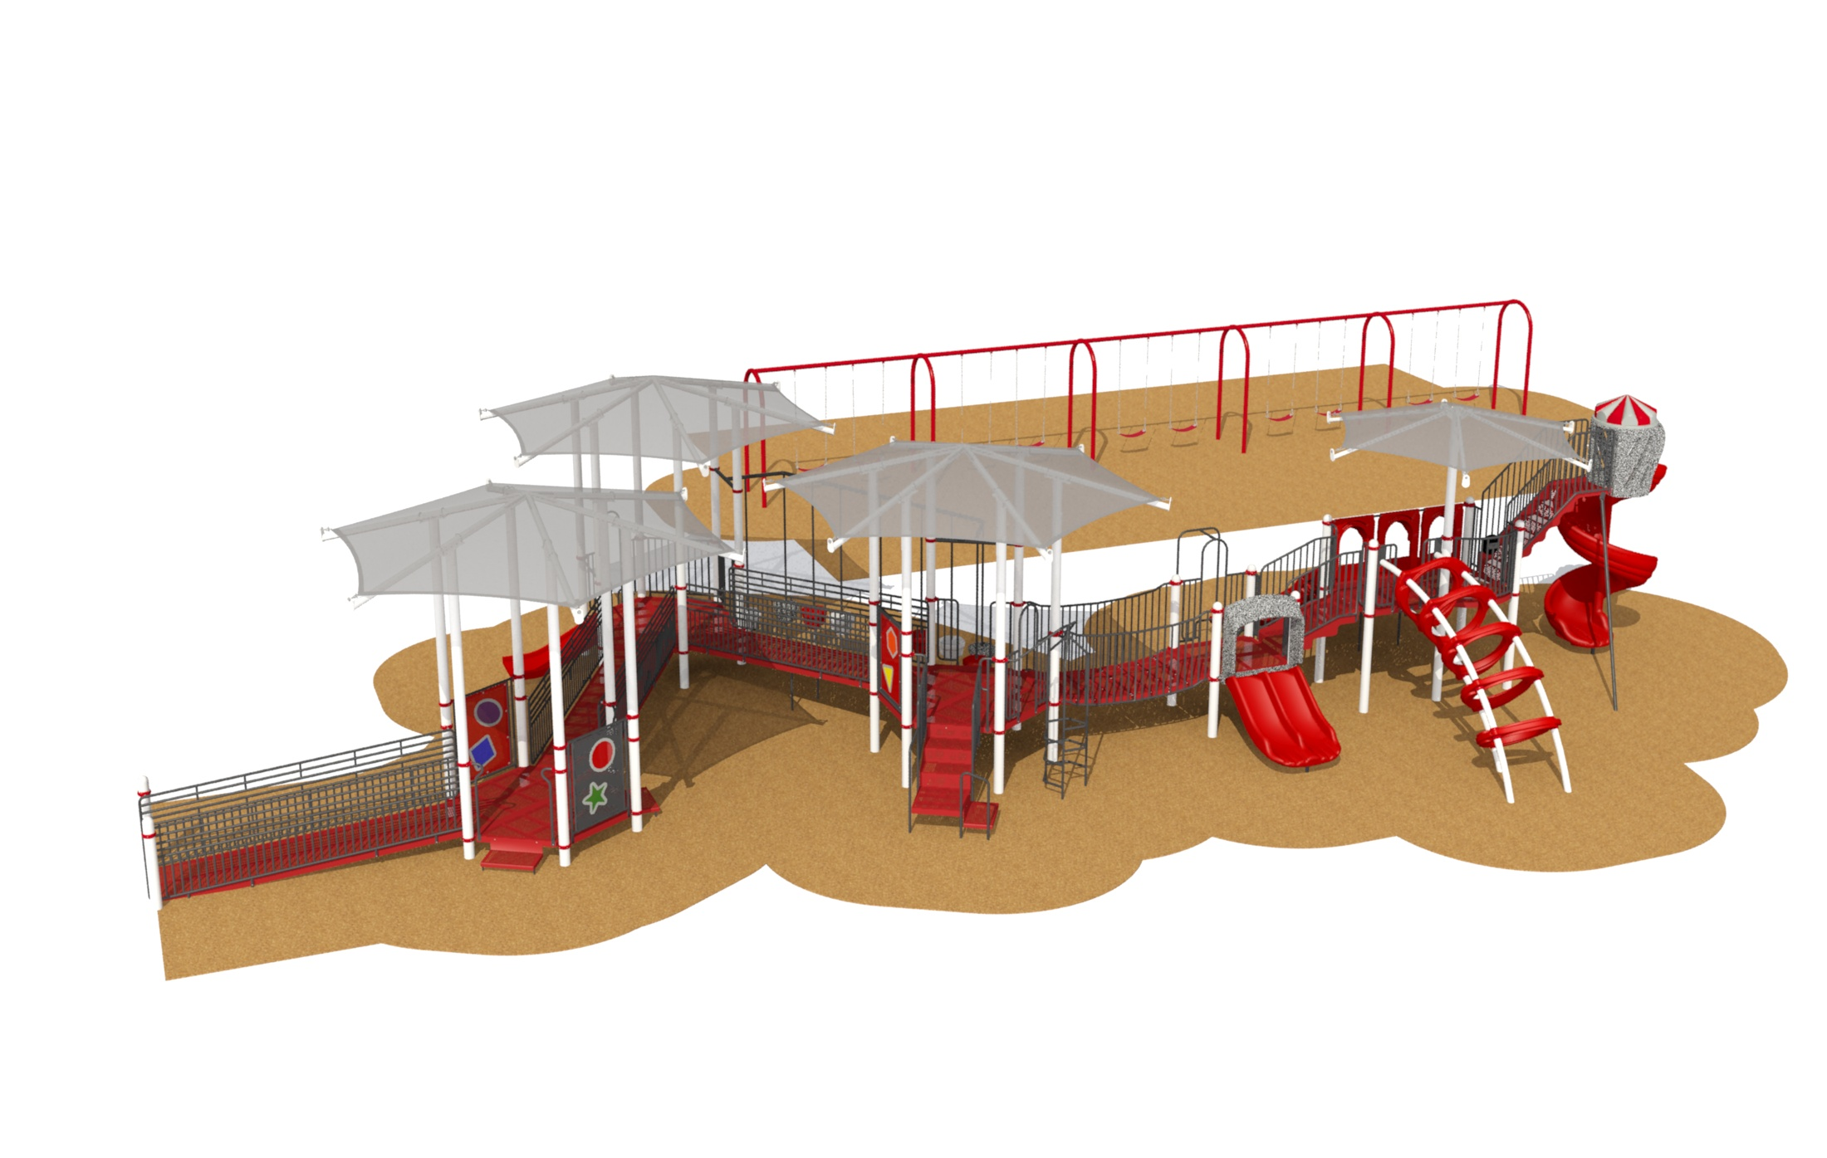
Playground Upgrades
Needs vary from building to building, but the priorities are to:
Replace wooden structures
Install age appropriate equipment
Expand opportunities for students with disabilities

Slide 11
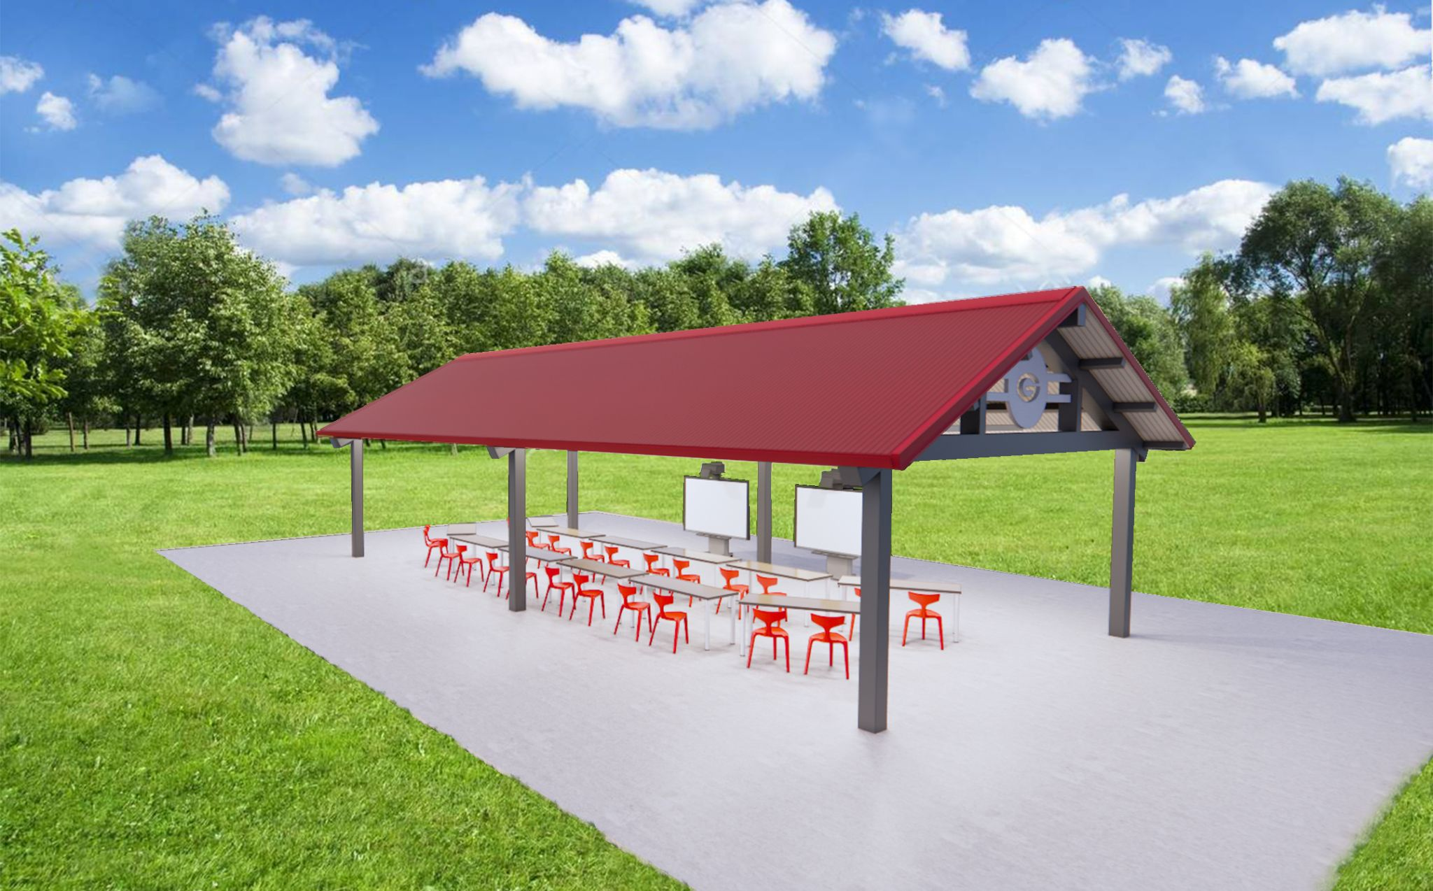
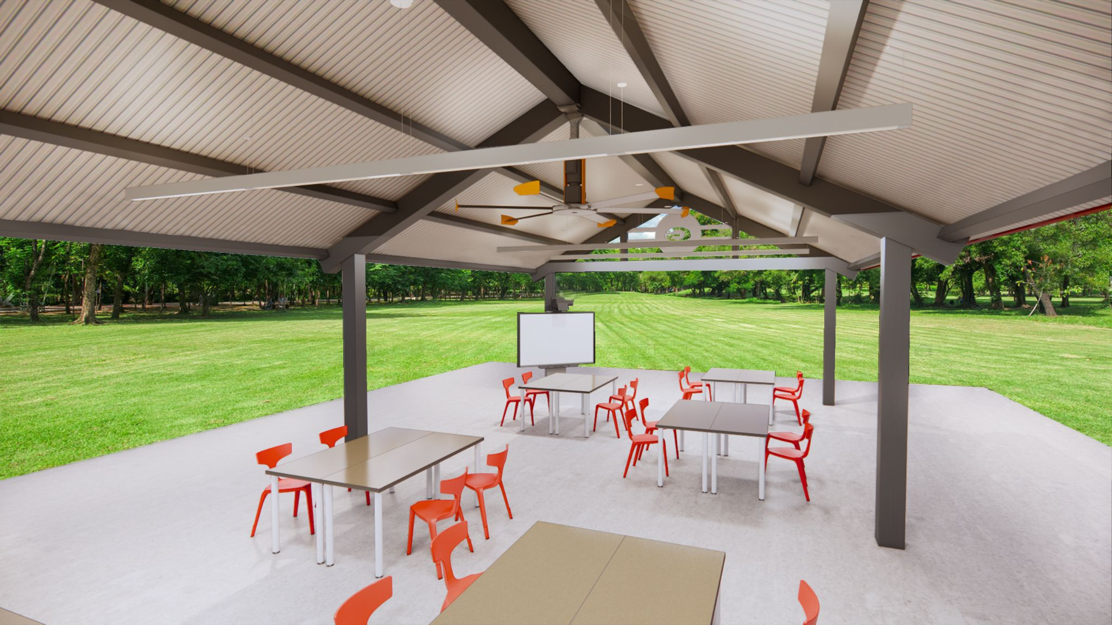
Outdoor Classroom Pavilions
Provide for additional learning spaces at each building
Offer improved air quality option
Support staff and student social/emotional well-being
Option for community use
One-time cost can be supported with Federal Funds
Lasting benefit to students/community

Slide 12
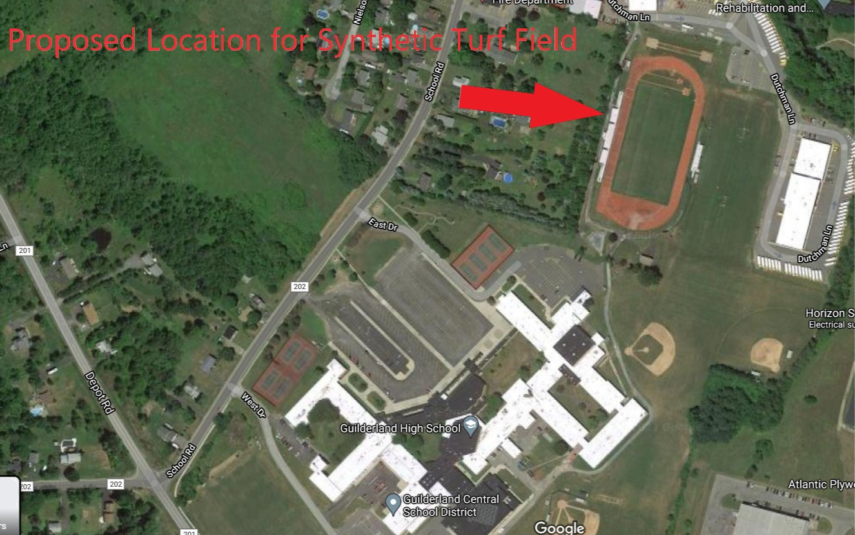
New Track and Turf Field
New construction to be completed within existing fence boundaries

Slide 13
Proposed Project
Replace existing 8 lane track and football field grass with synthetic turf
Includes drainage, power and safety control netting system that will cover corner of the track

Slide 14
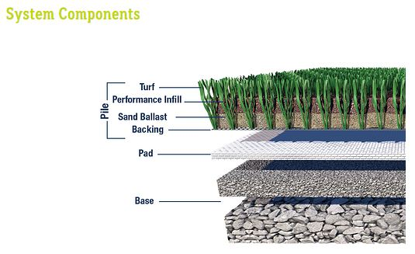
Synthetic Turf Basics
General
Construction of a
Synthetic
Turf Field

Slide 15
Synthetic Turf Fields
Warranteed for 15 years
Lasts ~15 years with proper maintenance
Rubber fill can be washed and reused many times
Cost to replace turf carpet ~$750,000-$950,000
Carpet is NOT hazardous waste; cost to dispose ~$125,000-$150,000
Can create opportunities for generating revenue

Slide 16
Who Will Benefit?
Students:
GHS Physical Education would gain a safe outdoor space to extend time spent outdoors
Impacts ~1,450 students enrolled in grades 9-12
Student Athletes:
Boys & Girls Soccer, Field Hockey, Football, Softball, Baseball, Boys & Girls Lacrosse, Boys & Girls Track and Field
Impacts ~800 athletes per year
Community:
Guilderland Youth Sports; TOG Summer Camps, School Events, MUD Ceremonies; Sectional Events; General Community Use

Slide 17
10 out of 15 schools in Suburban Council have synthetic turf or will in the next 12 months.
Guilderland Currently at a Competitive Disadvantage:
Play is different on turf
Sectionals/championships all played on turf
Home games often moved because of poor playing conditions
Teams practice in parking lots
Teams renting turf time at other locations

Slide 18
Estimated Full Value on Median Assessed
Home of $299,000 (Guilderland)
Project Cost Estimate | Amount Borrowed | Tax Impact Per $1,000 | Annual Tax Impact
$17,442,474 | $16,673,044* | $0.175 | $52
*$769,430 in CRRSA Federal Funding applied, lowering amount borrowed
For every $500,000 in Federal Funds applied to the project, the median homeowner tax impact is lowered by approximately one dollar.

Slide 19
Proposed Project Timeline
June 29, 2021 | Facilities Committee Recommendation
July 1, 2021 | Board of Education Review & Discussion
July 27, 2021 | Continued BOE Review & Discussion
August 10, 2021 | Board Adopts Bond Resolution
October 7, 2021 | Capital Project Vote
Nov. 2021- March 2022 | Project Design Development
April - July 2022 | State Education Department Review & Approval
August - Sept. 2022 | Bidding and Award of Contracts*
Oct. 2022 - August 2024 | Construction
*Note: Playgrounds and Track/Turf construction work would be under NYS contract and could start in Summer of 2022

Slide 20
Questions?

