Slide 1
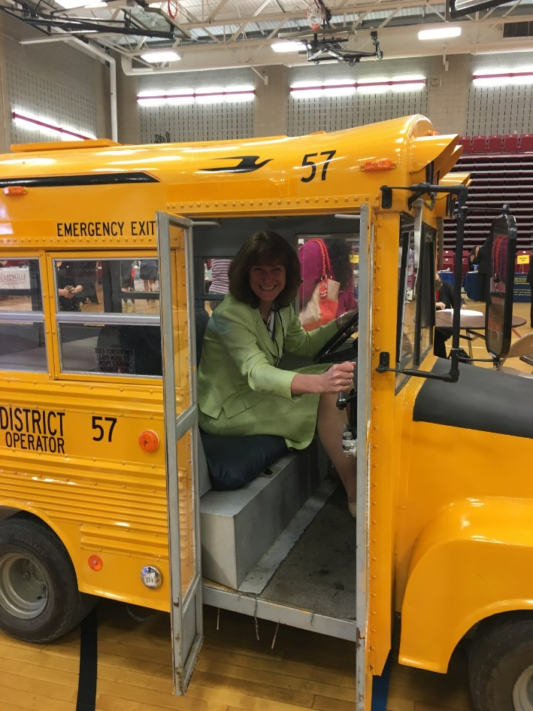
On the Road to
Future-Ready
The Superintendent’s
Proposed
2024-2025 Budget
March 5, 2024

Slide 2
AGENDA
Overview of 2024-2025 Priorities and Development Process
Review of Financial Context for Budget Development
Summary of Recommended Changes for 2024-2025
Next Steps in Budget Development Process

Slide 3
Key Questions:
What are our priorities?
What do our students need?
What can we afford now and sustain over time in our operating budget?
What items that had been funded through ARP-ESSR can be incorporated in the general operating budget in 2024-25?

Slide 4
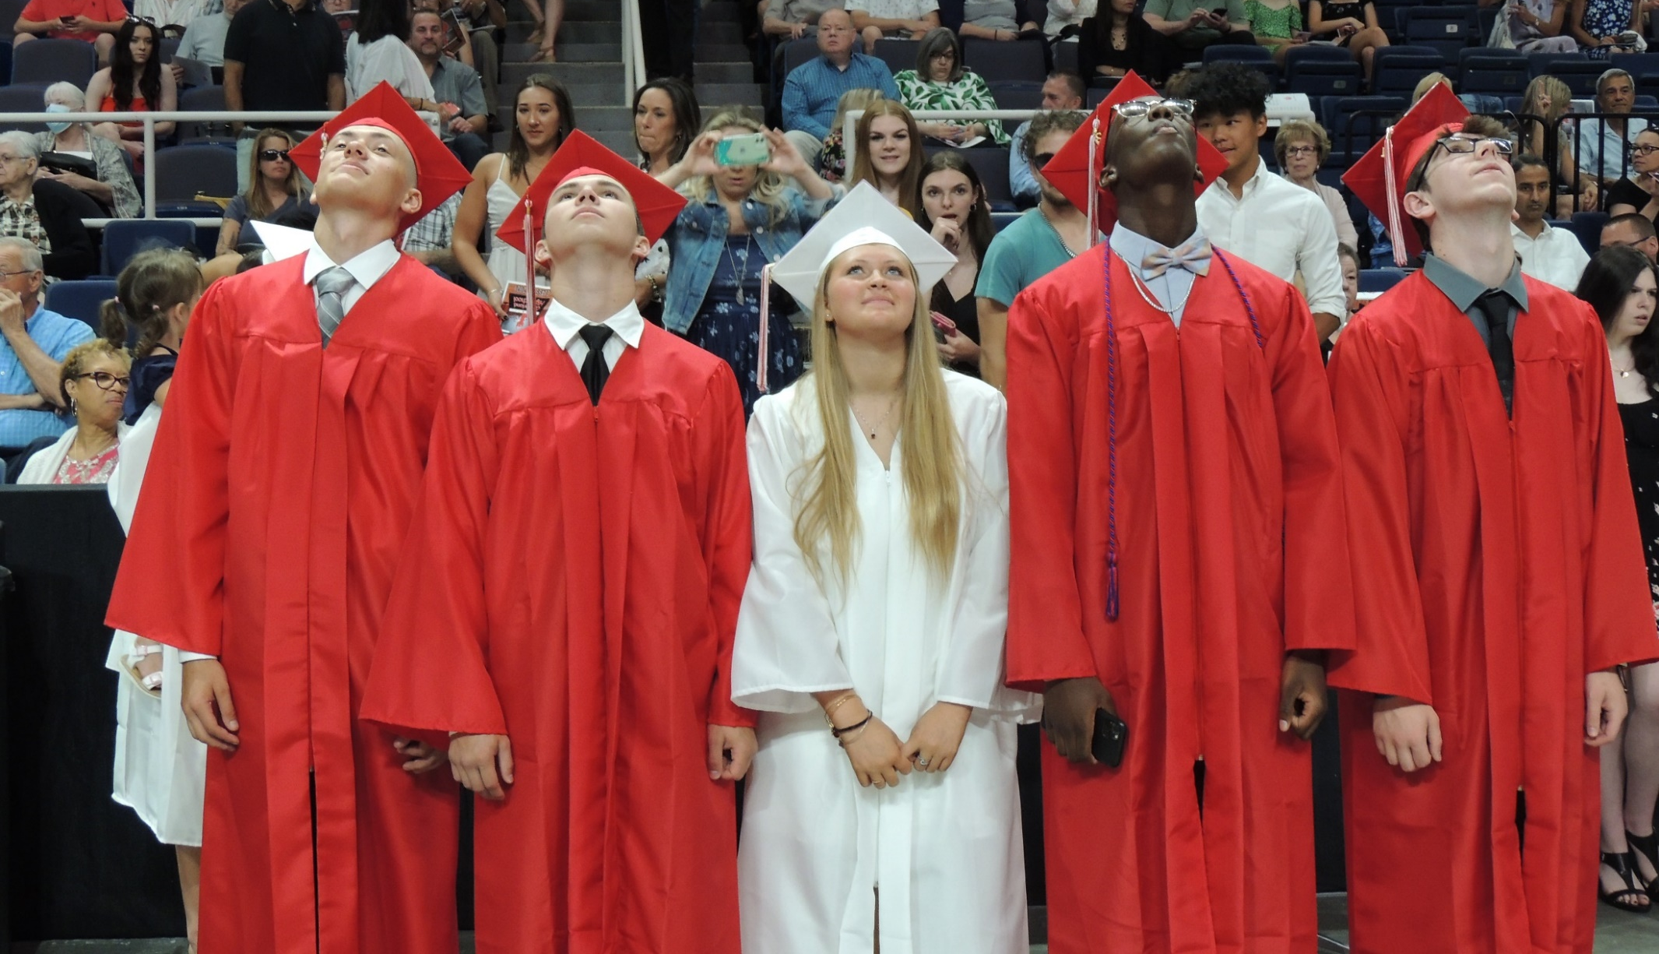
Our Mission

Slide 5
Mission Statement
It shall be the mission of the Guilderland Central School District to inspire ALL students to be active life-long learners, able to achieve their highest potential in a demanding and ever-changing global community.

Slide 6
Vision Statement
We will provide for ALL a safe and welcoming environment, where students, parents and staff are joined in the pursuit of academic excellence and personal growth. Thus, we shall provide a rich and rigorous education for ALL learners so that, upon graduation, they are poised, capable and ready to meet the developments, challenges and opportunities of the future.

Slide 7
Parents, Faculty/Staff, Students’ Top Themes on TE Survey
Parents | Faculty/Staff | Students
Maintain low class sizes | Maintain low class sizes | Preserve athletic programs
Preserve offerings in the arts | Increase paraprofessional support | Preserve offerings in the arts
Preserve rigorous academic programming | Continue support for students who require academic assistance | Preserve a wide variety of electives
Continue support for students who require academic assistance | Continue support for students’ social-emotional learning | Continue support for students who require academic support
Continue support for students’ social-emotional learning | Preserve offerings in the arts | Maintain low class sizes

Slide 8
Board members weigh in…
Board members share priorities for 2024-2025 spending plan via TE Survey:
Top Priorities
Maintain low class sizes
1. Preserve offerings in the arts
2. Continue support for SEL
Preserve rigorous academic programs
Increase teaching assistant support

Slide 9
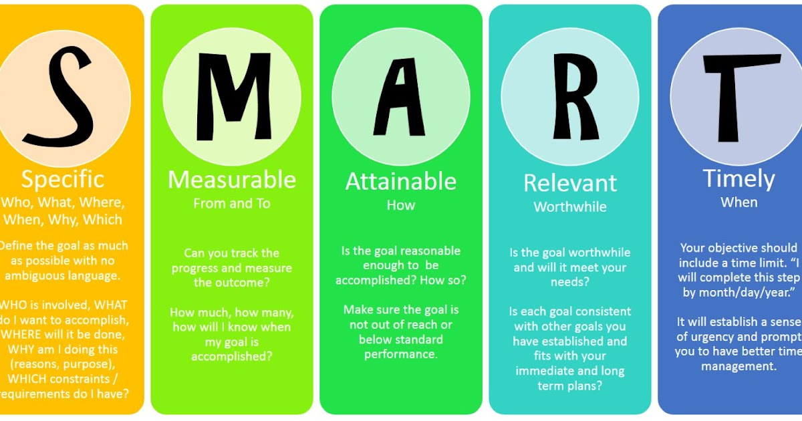
Board of Education Priority Areas:
2020-2025
Close achievement or opportunity gap
Focus on the whole child
Focus on diversity
Facilities

Slide 10
District Leadership Budget Planning
Review budget decisions from Spring 2023
Detailed analysis of student needs
  Enrollment
  Student academic, social and emotional support
  Robust, varied opportunities for learning, in and out of the classroom
Analysis of non-instructional costs
  Facilities Needs
  Transportation Challenges
Consider which currently grant-funded items are a priority for continued funding in general fund

Slide 11
Overall, this budget:
Maintains lower class sizes
Preserves existing programs and services for students
Preserves social and emotional supports
Addresses end of Federal COVID-relief grant funds in 2024
Reflects increased costs in areas outside of the district’s control (contract transportation and health insurance)
Addresses tax refunds while meeting the needs of students in 2024-25 and in future years
Does not exceed the tax levy limit and so requires a simple majority of voters for approval

Slide 12
Financial Context for
Budget Development

Slide 13
2023-2024 BUDGET & STAFFING
2023-2024 Voter Approved Budget – May 16, 2023 - $119,772,194
Yes – 1,513 (70.08%) No – 646 (29.92%)
Budget increase 8.99% Estimated Tax Rate increase 2.66%
FACTS ABOUT OUR SCHOOL DISTRICT IN 2023-2024
Enrollment 4,850
Employee Data 711 Full time
  233 Part time
  TOTAL 944
Number of Teachers 508
**Support Staff 409
Administrators & Supervisors 27
TOTAL 944
**(Teaching assistants, teacher aides & monitors, custodians, bus drivers/aides & mechanics,
maintenance workers, food service workers, office staff, technicians and non-instructional supervisors)

Slide 14
ENROLLMENT DATA
Grade Level | Current 2023-24 | Projected 2024-25 |  | Grade Level | Current 2023-24 | Projected 2024-25
K | 327 | 337 |  | 6 | 374 | 393
1 | 354 | 329 |  | 7 | 403 | 377
2 | 351 | 358 |  | 8 | 359 | 397
3 | 386 | 353 |  | Self-contained | 13 | 12
4 | 379 | 395 |  | 6-8 | 1,149 | 1,184
5 | 389 | 381 |  | 9 | 391 | 362
Self-contained | 29 | 35 |  | 10 | 351 | 388
 |  |  |  | 11 | 373 | 343
K-5 | 2,215 | 2,188
 |  |  |  | 12 | 353 | 381
 |  |  |  | Self-contained | 18 | 24
 |  |  |  | 9-12 | 1,486 | 1,498
Grade Level | Current 2023-24 | Projected 2024-25
K-12 | 4,850 | 4,870

Slide 15
Budget Vote Approval
Year | Yes | No | Voters | Levy Increase | Tax Levy Limit
2023-24 | 70.0% | 30.0% | 2,159 | 2.66% | 2.96%
2022-23 | 68.4% | 31.6% | 3,398 | 2.98% | 3.15%
2021-22 | 68.0% | 32.0% | 2,577 | 1.28% | 1.28%
2020-21 | 66.0% | 34.0% | 7,549 | 2.25% | 2.25%
2019-20 | 65.7% | 34.3% | 4,119 | 1.44% | 1.70%
2018-19 | 71.2% | 28.8% | 1,972 | 2.22% | 2.23%

Slide 16
2024-25 Executive Budget
Governor Hochul’s 2024-25 Executive Budget Proposal
  Makes two significant changes to Foundation Aid
  Fully funds expense-based aids
  Expands support for zero-emission bus purchases
  Proposes new best practices for teaching reading for young students

Slide 17
2024-25 Executive Budget Proposal
Aid Category | 2023-24 Enacted Budget | 2023-24 Expected State Aid | 2024-25 Projected Aid Based on Executive Budget
Foundation Aid | $24,203,145 | $24,278,544 | $25,568,482
Transportation Aid | $4,845,964 | $5,128,980 | $5,514,908
Building Aid | $3,094,526 | $3,094,527 | $2,859,575
BOCES Aid | $1,932,970 | $2,147,982 | $2,236,133
Software, Library, Textbook | $404,030 | $404,301 | $403,457
Hardware & Technology | $70,700 | $70,686 | $70,955
Excess Cost (SWD) | $1,606,271 | $1,520,004 | $1,479,773
UPK Allocation | $1,479,600 | $626,400 | $1,479,600
Total State Aid | $37,637,206 | $37,271,424 | $39,612,883
Comparison to 23-24 Enacted Budget |  | -$365,782 -1.0% | $1,975,677 5.2%
Note: State Aid is an estimate (not guaranteed),
subject to change based on actual data/expenses.

Slide 18
Tax Levy Limit (Property Tax Cap)
Must follow an eight-step formula determined by NYS
Formula limits the increase in the vast majority of expenses to 2% (based on CPI) for 2024-25
Result of the formula determines the amount that the levy can increase, setting a threshold for voter approval
If levy increase is less than the threshold amount, budget passes with 50% or more of the voters voting “yes”
If levy increase is greater than the threshold amount, budget passes with 60% or more of the voters voting “yes”
If budget is ultimately defeated, no increase in tax levy is permitted

Slide 19
2024-25 Preliminary Tax Levy Limit Calculation
Prior Year Tax Levy |  | $80,302,434
Tax Base Growth Factor | x | 1.0033
Subtotal Prior Year Tax Levy | = | $80,567,432
Prior Year PILOTS | + | $83,534
Capital Expenditures Net of State Aid | - | $2,153,898
Adjusted Prior Year Tax Levy | = | $78,497,068
Allowable Levy Growth Factor (Lesser: CPI or 2%) | x | 1.02
Growth Adjusted Tax Levy Subtotal | - | $80,067,010
Est. PILOTS | - | $0
ERS Exclusion | + | $11,887
Tax Levy Limit | = | $80,078,897
Capital Expenditures Net of State Aid | + | $2,425,558
Maximum Allowable Tax Levy Amount | = | $82,492,568
Maximum Allowable Increase $2,190,134 2.73% |  | 2.96%

Slide 20
Projected 2024-25 Tax Impact
2023-24 Budget $119,772,194
2024-25 Proposed Increase $5,561,893
Total $125,334,087
Total Percentage Increase 4.64%
Estimated Tax Impact 2.73%

Slide 21
Addressing Tax Certiorari Claims
From 2020-21 through 2022-23, the district paid $5.7M in property tax refunds from tax certiorari claims
The Crossgates case is currently under appeal, but we anticipate paying the refund in 2024-25
  The 2023-24 budget included $1.6M for this case; these funds can be put in the tax certiorari reserve at the end of the year
  The 2024-25 budget includes $400k for property tax refunds

Slide 22
2024-25 Budget Overview

Slide 23
2024-25 Budget Overview
Item | Change from 2023-24
Employee Health Insurance | $2,065,666
Instructional Salaries | $1,596,623
Property Tax Refunds (Tax Certiorari Claims) | -$1,200,000
Capital Expenses | $948,257
Non-Instructional Salaries | $706,076
TRS / ERS | $563,787
Contract Transportation | $480,660
BOCES | $325,722
Other | $75,102
Total | $5,561,893

Slide 24
Recommended Changes

Slide 25
2024-25 Projected
Elementary Class Size Averages
 | Altamont | Guilderland | Westmere | Lynnwood | Pine Bush | AVG
K | 23* (-1) | 19 | 20 | 21.67 (-1) | 17.5 | 19.8
Grade 1 | 16 (+1) | 21.67 (-1) | 19.75 (-1) | 17.5 | 18 | 18.6
Grade 2 | 18 (-1) | 18.5 (+1) | 23* | 23* (-1) | 22 | 21.1
Grade 3 | 17.33 (+1) | 22 (-1) | 21 | 23.67 (-1) | 20 | 19.6
Grade 4 | 23.5 (-1) | 21.25 | 24* | 20.5 | 21.25 | 21.9
Grade 5 | 18.67 (+1) | 20.5 (-1) | 23.25 | 23.33 | 20.25 | 21.2
*Under Review
4 FTEs in “Unassigned” positions in budget
Overall Class Size Average: 20.5
Reduction of 6 FTEs

Slide 26
Recommendations
Elementary Schools
Program/Service | FTEs | Cost | Rationale
Enrichment Staff and Materials | -2.0 | -$175,800 and -$4,830 | Open positions due to June 2023 resignations; not filled in anticipation of sun-setting grant dollars, other needs
Reading Positions at AES and LES | 2.0 | $175,800 | Previously grant-funded positions; need for student reading support continues
Social Worker | 1.0 | $87,900 | Previously grant-funded position split between WES and GES; SW support continues to be a need

Slide 27
Middle School Class Sizes
Grade Level | # of Sections | Enrollment | Class Size Average
6 | 16 | 393 | 24.6
7 | 16 | 377 | 23.6
8 | 16 | 397 | 24.8

Slide 28
Recommendations
Middle School
Program/Service | FTEs | Cost | Rationale
Spanish Teacher | 0.4 | $28,400 | 0.2 previously grant-funded; needs continue and grow; 0.4 will make position FT
Reading Support | 0.2 | $14,200 | To cover one section of reading/tutorial for Grade 6
Unified Physical Education | 0.1 | $7,100 | Added as pilot during 2023-24 school year with unassigned FTE
Math Curriculum Materials (i-Ready) | NA | $47,253 | Renewal of three year contract for print and digital access to curriculum; Multi-year contract saves $17,000

Slide 29
Recommendations
High School
Program/Service | FTEs | Cost | Rationale
Clerical Support in Counseling Office | 1.5 hours | $10,976 | Added responsibility for supporting social work office
World Language Spanish Italian | 0.4 0.2 | $42,600 | Reinstating Spanish (2) and Italian (1) sections based on projected enrollment
Calculators | NA | $2,500 | Graphing calculator sets need to be replaced and replenished

Slide 30
Recommendations
High School
Program/Service | FTEs | Cost | Rationale
Cafeteria Tables | NA | $6,000 | Ongoing transition to bench-style seating; fold up quickly, faster cleaning
Nurse’s Office Privacy Curtains Replacement | NA | $1,700 | New, weighted, fire-retardant, machine washable curtains are needed

Slide 31
Staffing/Service Recommendations
Special Education
Program/Service | FTEs | Cost | Rationale
Elementary Comprehensive Skills Program: Special Education Teacher Teaching Assistants Speech Social Worker | 1.0 4.0 1.0 0.4 | $379,400 | Need for fourth elementary Comprehensive Skills Classroom program; previously grant funded. Two classrooms at GES Two classrooms at PBES; currently three classrooms housed at AES
Special Education Tuition Reductions |  | -$150,000 | Students graduating from programs or reaching the age of 22

Slide 32
Recommendations
Athletics
Program/Service | FTEs | Cost | Rationale
Equipment/Supplies/ Uniforms for existing sports programs | NA | $16,150 | Increased number of programs (girls’ golf, unified bocce, eSports, girls’ wrestling); Includes funding for new uniforms and 20 FB helmets
Officials’ Fees | NA | $4,354 | Officials’ fees continue to increase for both boys’ and girls’ sports

Slide 33
Recommendations
Athletics
Program/Service | FTEs | Cost | Rationale
Boys’ Modified Volleyball | NA | $6,932 | GCSD is at a competitive disadvantage without a MS program to develop young players
Girls’ Varsity Wrestling Coach | NA | $5,065 | Year 3 of program, which continues to grow

Slide 34
Staffing/Service Recommendations
Music
Program/Service | FTEs | Cost | Rationale
Musical Accompanists | NA | $2,500 | Accompany music performing groups during performances
Music Equipment | NA | $10,000 | Grant funds supported music equipment purchases in previous 2 years; This begins to restore line in GF
Music Repair | NA | $2,000 | The increase will bring total repair budget to $11K
Music (MixCraft) | NA | $790 | Need software upgrade in music tech lab at GHS

Slide 35
Staffing/Service Recommendations
District Wide
Program/Service | FTEs | Cost | Rationale
Teacher on Special Assignment (Diversity, Equity and Inclusion) | 1.0 | $87,900 | Currently funded through grants; need to support DEI efforts at the classroom level continues
Library Data Bases | NA | $14,058 | Replaces NOVEL databases previously purchased through NYS library, which are no longer available
Replace/Upgrade Securly | NA | $5,000 | Seeking another/more reliable tool to monitor student technology usage

Slide 36
Recommended Changes
Transportation/Maintenance
Program/Service | FTEs | Cost | Rationale
Contract Transportation Services | NA | $480,660 | Bus driver shortage resulted in an increase in out-of-district runs that had to be contracted out in 2023-2024; will look to bring routes back to district, if possible
Gas/Diesel | NA | -$30,650 | Projected decrease in fuel costs
Maintenance and Facilities |  | $92,000 | Increased costs for supplies, updated bids for natural gas, cost of uniforms, etc.

Slide 37
Recommended Changes
Business Office/HR
Program/Service | FTEs | Cost | Rationale
Legal – Attorney Fees | NA | -$85,000 | Reflects decrease in anticipated expenses for 2024-2025 school year (tax certiorari claims)
Add RecruitFront Module | NA | $31, 000 | HR management platform to add time and attendance module to enhance efficiency and accuracy

Slide 38
Summary of FTEs in proposed plan
Staff | Total FTEs
Teachers | 466.2
Teaching Assistants | 108.5
Student Support | 39.5
Aides/Monitors | 32.6
Clerical/Confidential | 54.6
Maintenance and Custodial | 53
Transportation | 75.5
Informational Technology | 9
Administrators (Non-Instructional) | 15
Administrators (Instructional) | 27
Notes:
Food service workers are included in the school lunch fund
Used 7 hour days for FTE conversion of positions budgeted by hours

Slide 39
If additional resources become available
Program/Service | FTEs | Cost | Rationale
Elementary School Counselor | 1.0 | $87,900 | Currently grant funded position between LES and AES; SEL needs continue for our students.
K-8 Positivity Project Teacher Leaders | NA | $10,800 | Positions have been instrumental in the implementation and continued success of program
Varsity Assistant Coaches | NA | $2,726 $3,505 $3,505 $3,116 $3,116 | Field Hockey Boys’ Basketball Girls’ Basketball Baseball Softball

Slide 40
If additional resources become available
Program/Service | FTEs | Cost | Rationale
Girls’ Flag Football | NA | $12,500 | Opportunity for girls to participate in new sport Spring 2025
Replenish Tax Certiorari Reserve | NA | Will Vary | Help address new tax certiorari claims in the Town of Guilderland
Assorted Materials/Supplies/Travel for Business/Art/FACS/ Organic Garden | NA | $6,200 | Instructional leaders requested additional funds for a variety of items during stage 2 of the budget development process

Slide 41
This proposed plan also addresses facilities needs
Replaces bleachers in the East Gym ($148,128)
Funds costs associated with pre-referendum work ($15,000)
Supports the work of the Future Ready Task Force
  Long range planning to re-envision instructional space across the district
  5 subcommittees at work: elementary programs, humanities, STEAM/career skills, performing arts, gathering spaces
  Goal to bring first referendum to voters in May, 2025

Slide 42
This Proposed Plan
Recognizes priorities shared by GCSD stakeholders by maintaining lower class sizes
Maintains programs and services to support students
Incorporates high priority needs previously funded by COVID relief grant funds
Addresses increased costs that are out of the district’s control: contract transportation costs, health insurance increase, large tax refunds
Respects tax payers
Addresses tax refunds while continuing to address the needs of students for 2024-25 and beyond

Slide 43
This Proposed Plan
Recognizes that there are still some unknowns that will affect our operations and the budget
  Outcome of the state budget
  Final bid result on energy costs
  Potential (positive) changes to special education billing from BOCES
  Consideration of potential programmatic changes for self- contained special education classroom at GHS
  Other?

Slide 44
Next Steps
March 12, 2024: Question and Answer Session
March 26, 2024: BOE Budget Workshop
April 16, 2024: Board Adopts Budget
May 7, 2024: Budget Hearing
May 21, 2024: Budget Vote and Board Election

Slide 45
Questions?

